Slide 1


Correctional officers peer educators
training program
Let’s talk
about hep C: stop the spread, reduce the risk
Module 1:
Prisons and hep C

Slide 2


Program Overview
Module 3: HepPEd Resources
Module 1: Prison and hep C
Module 2: Peer Education Skills

Slide 3
Pre-session evaluation

Slide 4
In this session we will learn…
Where the liver is and what it does
What is ‘hepatitis’ and what does it do to the liver
What are the tests for liver disease
What is hep C and how is it spread
Why inmates should get tested for hep C infection
Why inmates should get treated for hep C while in prison
What are the tests for hep C infection
What is the treatment for hep C infection
What happens after hep C is cured
How to prevent the spread of hep C in the prisons

Slide 5

What do
you know about the liver?

Slide 6


Where is the liver and
what does it do?
IN
We can’t live without a liver,
because it…
Breaks down the food you eat
Builds new proteins for the body
Stores sugar for energy as well
as vitamins and minerals for the body
Cleans the blood of toxins
OUT
Protein
Sugar
Vitamins
Minerals

Slide 7
The liver is like…
A waste
processing plant
A warehouse for storage
A factory

Slide 8



What is ‘hepatitis’ and what happens when it persists or becomes chronic?
Normal liver
Hepatitis
Inflammation of the liver
Cirrhosis
Liver becomes stiff,
scarred and nodular

Slide 9
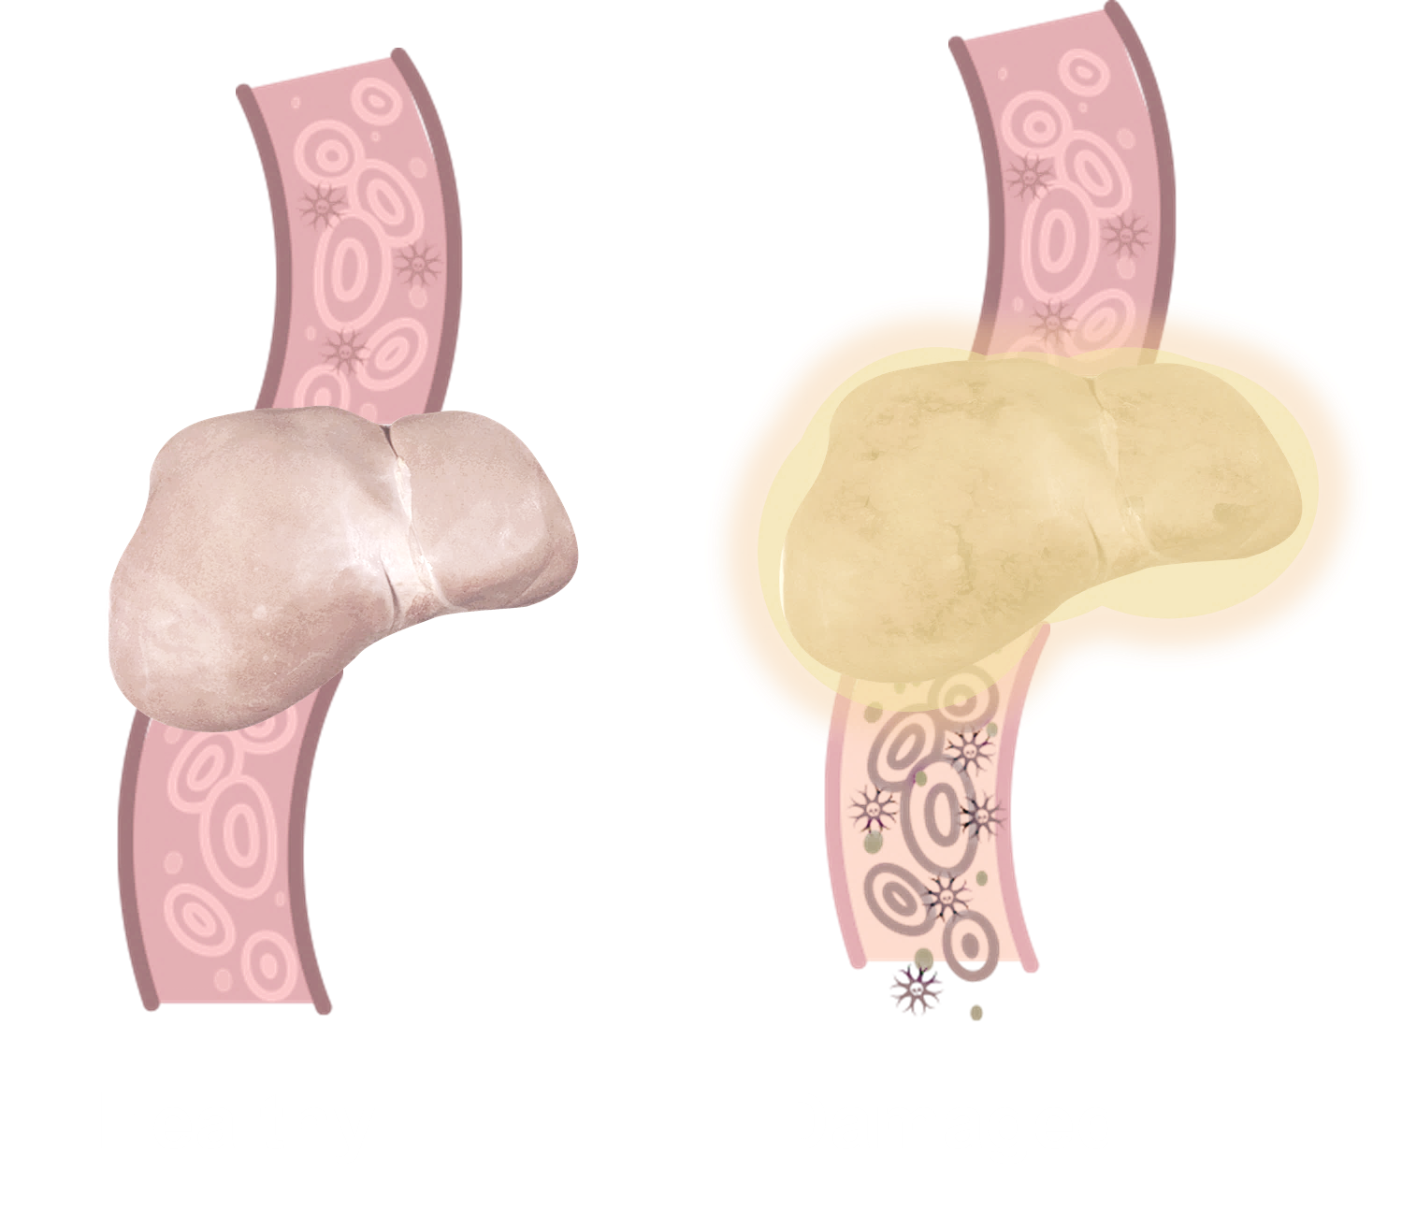
What are the tests for liver disease?
Liver function tests (LFTS):
LFTs measure elements called enzymes made in the liver but found in the blood
High levels of enzymes tell your doctor that your liver may be damaged
Liver enzyme tests include ALT (Alanine transaminase) and AST (Aspartate transaminase)
Normal liver
Cirrhosis

Slide 10
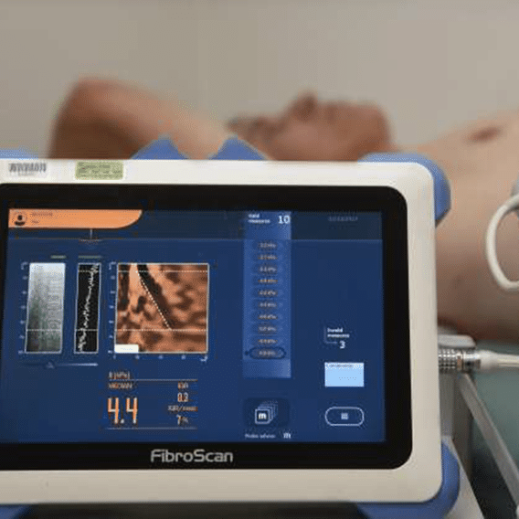
Tests for liver scarring (fibrosis)
Fibroscan
A quick and painless sound waves test
similar to an ultrasound test in pregnancy
Measures how much scarring
has built up in the liver
APRI test (Aspartate Aminotransferase
to Platelet Ratio Index)
Some of the liver function tests can be used to advise whether there is cirrhosis or not
Fibroscan

Slide 11


Teach back scenario
I’m feeling crook, what tests do I need to check for liver damage?
What advice would you give these guys?
Why is a healthy liver important to us?

Slide 12
Most people will not feel sick when they get the virus but it will damage their liver slowly.
What is hep C?
Hep C is a viral infection affecting the liver causing inflammation and scarring.
There are two stages of hep C infection:
  Acute hep C: is when the virus first causes infection – 1 person in 4 gets rid of the infection naturally
6 months
  Chronic hep C: is what happens
  in the remaining 3 out of 4 – the virus
  stays forever unless it is treated

Slide 13



How common is hep C?
Across the world around 1 in 100 people has chronic hep C
In Australia around 1 in 250 people has chronic hep C
In Australia around 1 in 5
people who inject drugs
has chronic hep C

Slide 14
What about inside the prisons?
In the Australian prisons more than 1 in 10 people have chronic hep C
Each year, 1 in every 10 people who enter prison without hep C infection, gets infected inside prison

Slide 15


How is hep C spread amongst prisoners?
Sharing injecting needles or equipment
Sharing tattooing equipment
Blood to blood contact in fights
Sharing piercing equipment
Sharing razors and toothbrushes
Unprotected sex
(when blood is involved)

Slide 16

What are the chances of catching hep C while working in the prisons?
The risk is low.
Less than 1 in 100 chance of becoming infected – even when the blood is from someone known to have chronic hep C.
There is a risk, because:
More than 1 in 10 inmates have chronic hep C
Blood-to-blood contact can happen with correctional officers in:
Needle stick injuries
Breaking up fights
Cleaning up blood spills

Slide 17
Teach back scenario
A new correctional officer has never heard of hep C and is worried about catching it.
How would you explain hep C to the new officer, making sure they know what it is, how common it is in the prisons, and how it is spread?

Slide 18
Why should inmates be encouraged to get tested for hep C?
They will know where they stand – they might have been infected
without knowing it
They can avoid transmitting to their family, and to their mates, and to correctional officers and healthcare staff
They can get treated and cured in prison

Slide 19

The results stay between the person and the nurse or doctor.
What are the tests for hep C?
An antibody (Ab) test tells if someone has EVER been infected with hep C.
Ab
An RNA test (also called a PCR or viral load test) tells if the hep C infection is active NOW.
Other viruses such as HIV and hep B are also transmitted blood-to-blood, so testing for these viruses at the same time may be a good idea.
RNA

Slide 20
What do the hep C test results mean?
Remember if the tests show chronic hep C, the inmate needs to get checked for liver disease:
Antibody
RNA (PCR)
+
=
Active
infection
Ab
RNA
+
=
Ab
Previous infection
Tests for scarring
Fibroscan
APRI
Liver function tests
+
=
Never infected

Slide 21
Treatment is 1 tablet, once a day for 12 weeks
OR
3 tablets once a day for 8 weeks.
How do you treat hep C?
In the past…
Now…
Interferon injections
Direct-acting-antivirals
(DAAs) are tablets only
Lots of side effects
No side effects
24-48 weeks of treatment
Simple, quick treatment
Only 50-60% cure
95% cure

Slide 22
What are the important things to know for those on treatment for hep C?
It’s pretty simple,
just pills each day and follow up visits with the nurse or doctor.
If an inmate gets
released before the end of their treatment the
nurse will give them
their medication or prescription to keep them going on the outside.
An inmate’s medication should go with them if they get transferred to another centre.

Slide 23

Why should inmates get treatment for hep C while inside?
Make it safer for everyone working in the prisons.
Contribute to Australia’s national efforts in eliminating hep C by 2030.
As a significant proportion of Australians with hep C spend time in prison, this is an important time for intervention.
If all inmates with hep C are tested, treated and cured, no new infections can occur by any means. This is called ‘Treatment as Prevention’.

Slide 24
Teach back scenario
The argument for hep C testing and
treatment in the prisons
Your partner or friend on the outside has heard about inmates being tested and treated for hep C, and wants to know why bother.

Slide 25
What happens after treatment?
A final PCR blood test is taken 1 to 3 months after treatment is completed
For the 1 out of 20 who does not clear the virus, another course of 12 weeks of treatment (called Vosevi) is very effective – 9 out of 10 people are cured.
19 out of 20 clear the virus after DAA treatment, meaning they are cured

Slide 26

What happens after cure?
People cured from hep C generally feel better and have more energy
Once a person
is free of hep C it does not mean they are immune. They still can get the infection again.
Liver inflammation stops
Scarring in the liver
may slowly improve

Slide 27
How can the risk of hep C
transmission in the prisons be reduced amongst inmates?
Help decrease drug taking by suggesting inmates use their drug another way like snorting, swallowing,
or shafting.
Encourage inmates to tell their mates to get tested and treated if they’ve got the virus.
Spread the word – let inmates know not to inject drugs too much.

Slide 28
Teach back scenario
One of the inmates who just finished hep C treatment is worried about getting infected again.
How would you advise the inmate to avoid reinfection?

Slide 29






This program was developed by:
In partnership with…
State and Territory Justice Health organisations
State and Territory Corrections Organisations
National and state-based Hepatitis and Drug-User Organisations
With funding from…

Slide 30
Post-session evaluation

