Slide 1

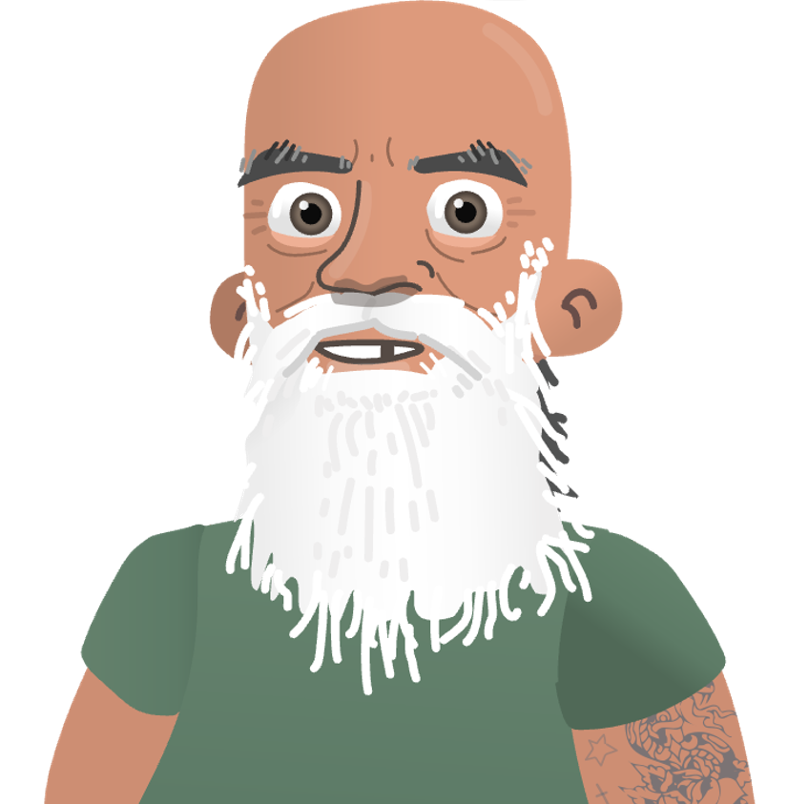
Prisoner peer educators training program
Let’s talk
about hep C: test, treat, cure, prevent
– it’s simple
Module 3:
The HepPEd Program

Slide 2
In this session we will…
Do a revision activity from Module 2
Get an overview of the HepPEd program
Get to know the HepPEd resources for prisoners
Do some practice activities:
    working out your style
    working out your settings
    working out your messages
    using the HepPEd resources
    facing tough questions

Slide 3
Take home messages from Module 2
  Peer education makes use of peer influence in a positive way.
  Good peer educators are respectful, energetic, non-judgemental, and motivated.
  Peer educators provide information about hep C and encourage those around them to get tested and treated for the virus.
  Peer education is ‘opportunistic’, which can take place wherever and whenever the opportunity arises.
  Be careful not to disclose any private or confidential information.

Slide 4
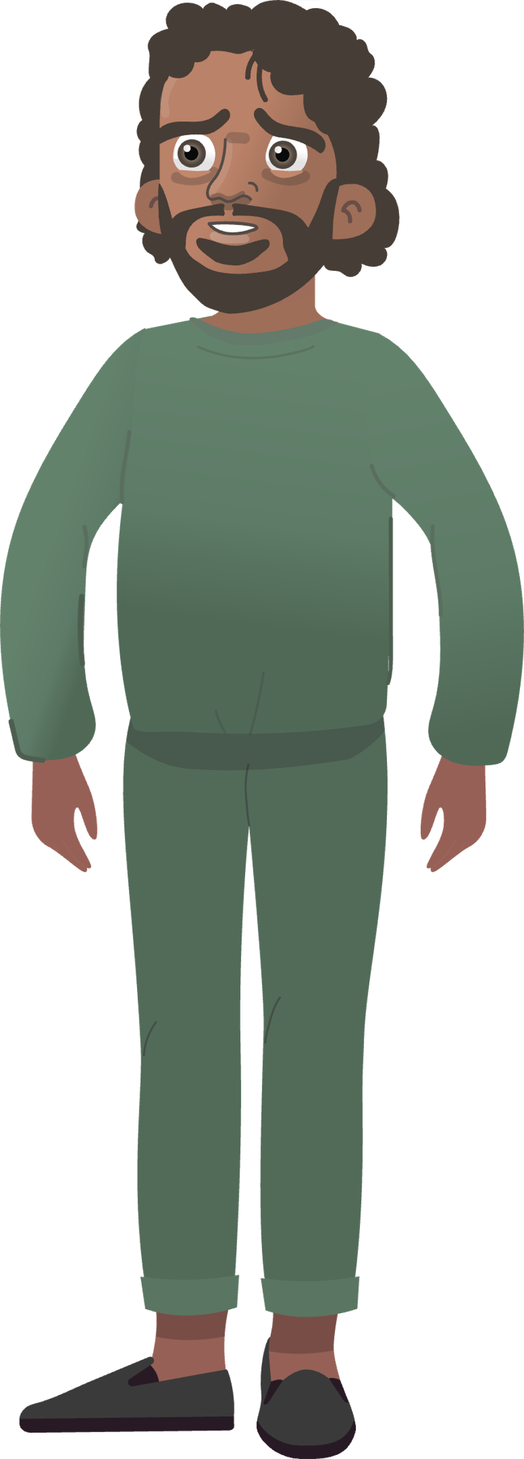
Revision activity from Module 2
T | F
Peer educators just give instructions to their peers (prisoners)
T | F
Peer educators need to be much smarter than their peers
T | F
Peer education should happen in a classroom
?
T | F
It is important that peer education is accurate
T | F
Peer education is trying to change people’s behaviour
T | F
Hep C peer education can happen anywhere
?
T | F
Hep C peer educators help other prisoners to get tested and treated
T | F
Peer educators have to do all the talking during a peer education session

Slide 5
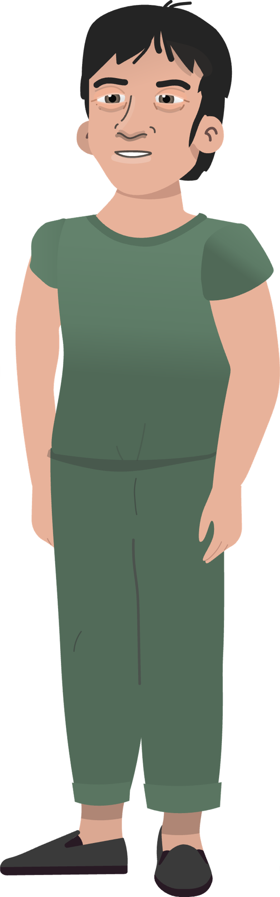

What is the HepPEd program and what is it trying to do?
The HepPEd program is trying to educate everyone in the prison about hep C testing, treatment, and prevention including by…
improving knowledge (get everyone in the know)
changing attitudes (reduce stigma)
increasing practical support for hep C testing & treatment
The HepPEd program is an education program about hepatitis C (hep C).
It is designed especially for the prisons, and has three target audience groups:
Prisoners
Correctional officers
Healthcare workers

Slide 6
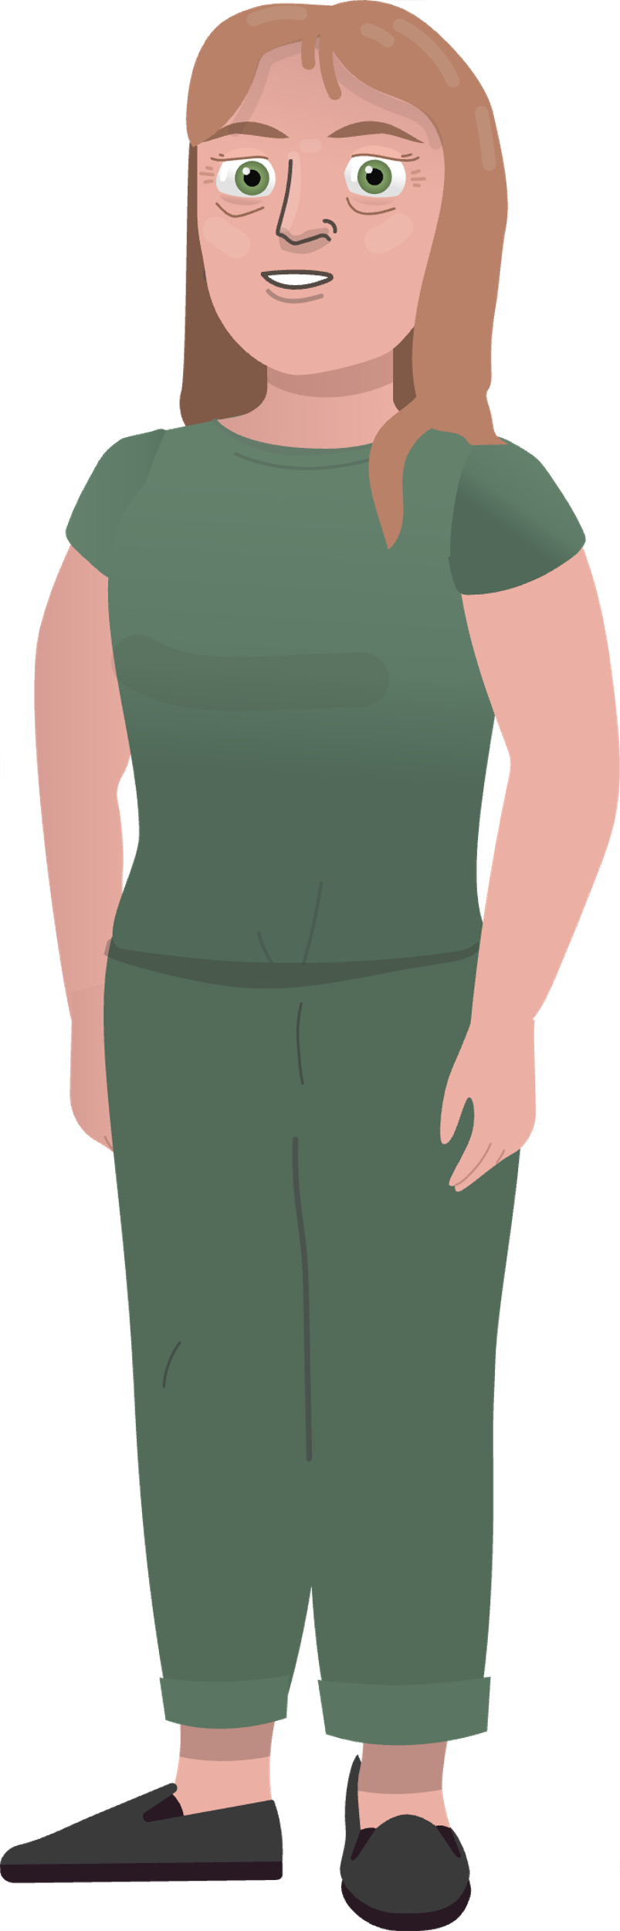
The HepPEd prisoner program
Messages
Key topics
How simple testing is
How simple treatment is
How to prevent getting infected
Looking after personal well being
Resources
Short animated videos
Comic books
Information booklet
Posters
Merchandise
True/false knowledge check
Peer educator program
Let’s talk
about hep C:
test, treat,
cure, prevent
– it's simple

Slide 7
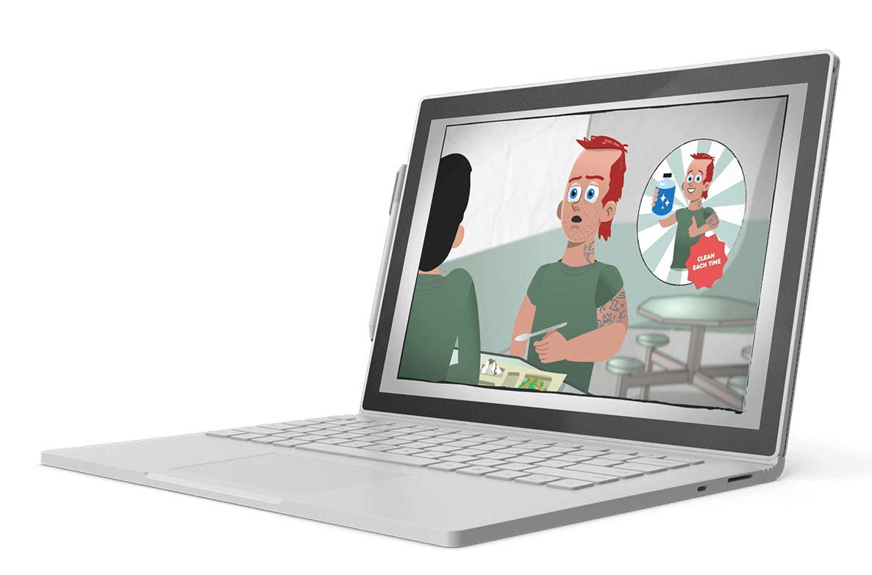
The HepPEd prisoner program
Resources: videos
Let’s talk
about hep C:
test, treat,
cure, prevent
– it’s simple

Slide 8

The HepPEd prisoner program
Video: Get tested - it’s simple
Let’s talk
about hep C: test, treat,
cure, prevent
– it's simple

Slide 9
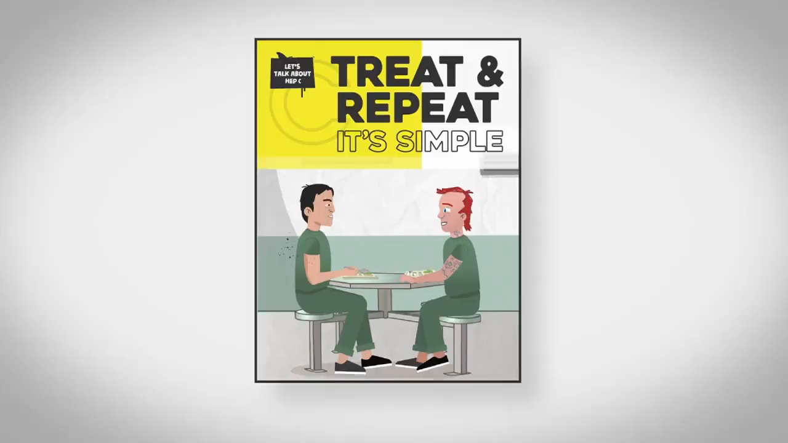
The HepPEd prisoner program
Video: Treat & repeat – it’s simple
Let’s talk
about hep C: test, treat,
cure, prevent
– it's simple

Slide 10

The HepPEd prisoner program
Video: No judgement
Let’s talk
about hep C: test, treat,
cure, prevent
– it's simple

Slide 11
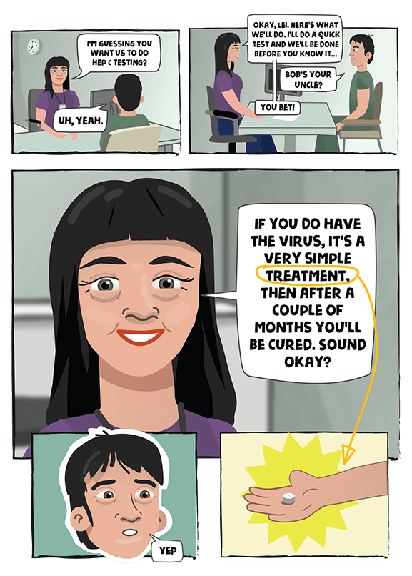


The HepPEd prisoner program
Resources:
comic books
Let’s talk
about hep C: test, treat,
cure, prevent
– it's simple

Slide 12
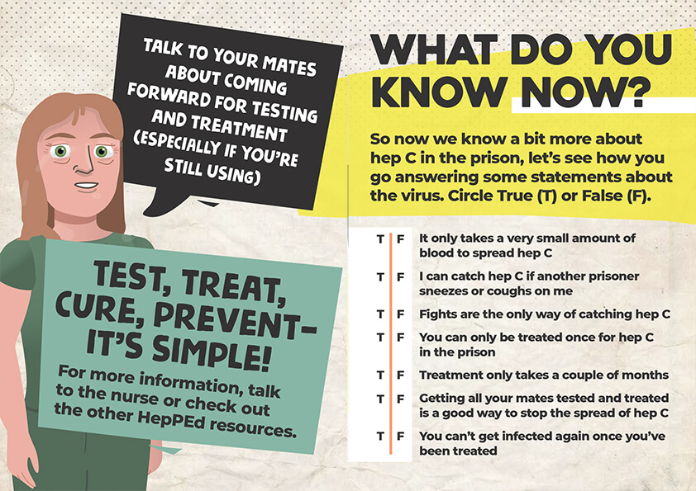


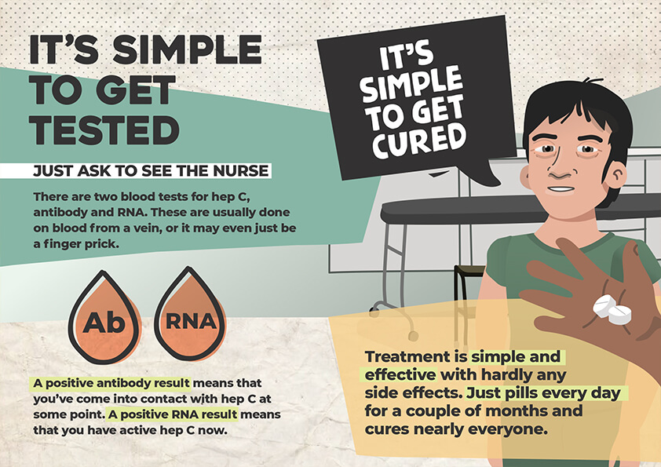
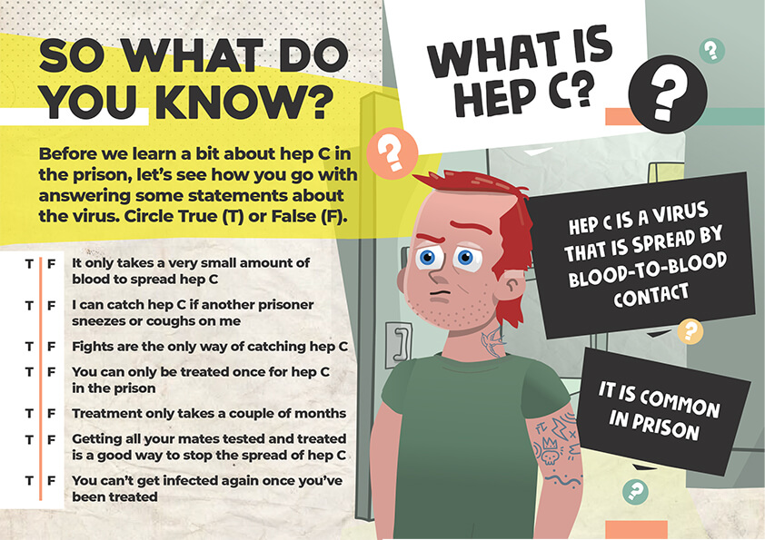
The HepPEd prisoner program
Resources:
booklet
Let’s talk
about hep C: test, treat,
cure, prevent
– it's simple

Slide 13




The HepPEd prisoner program
Resources:
posters
Let’s talk
about hep C: test, treat,
cure, prevent
– it's simple

Slide 14


The HepPEd prisoner program
Resources:
merchandise
Let’s talk
about hep C:
test, treat,
cure, prevent
– it’s simple

Slide 15

Practice activities
Working out
your style

Slide 16
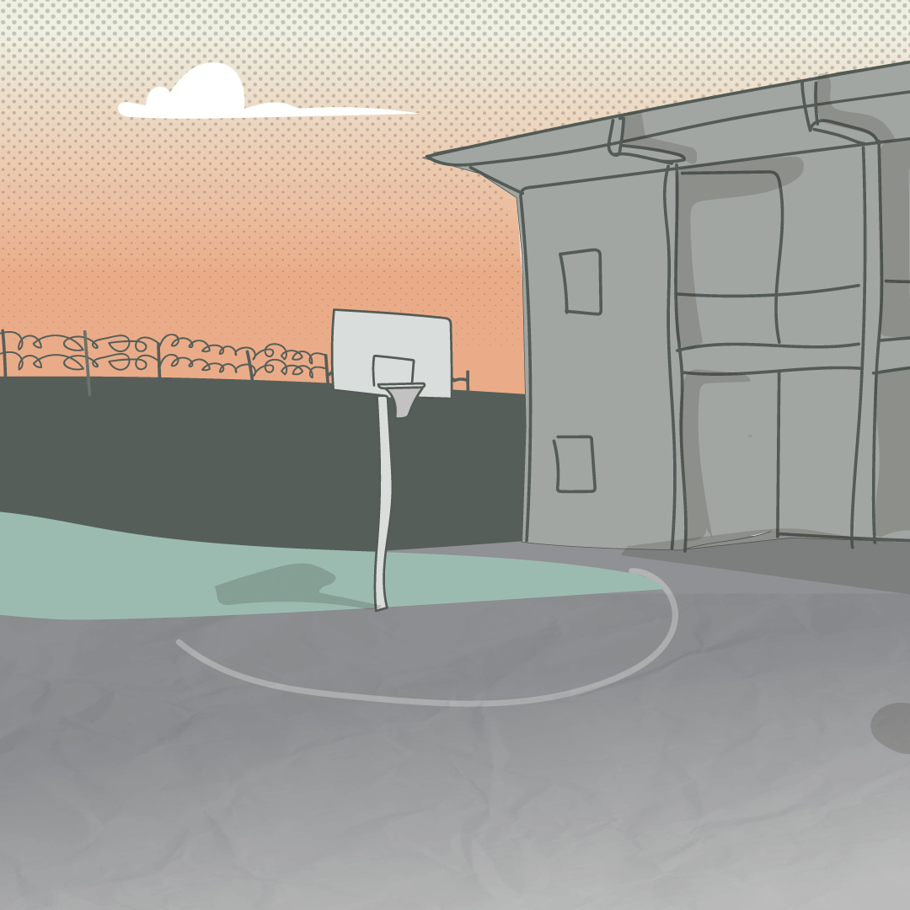
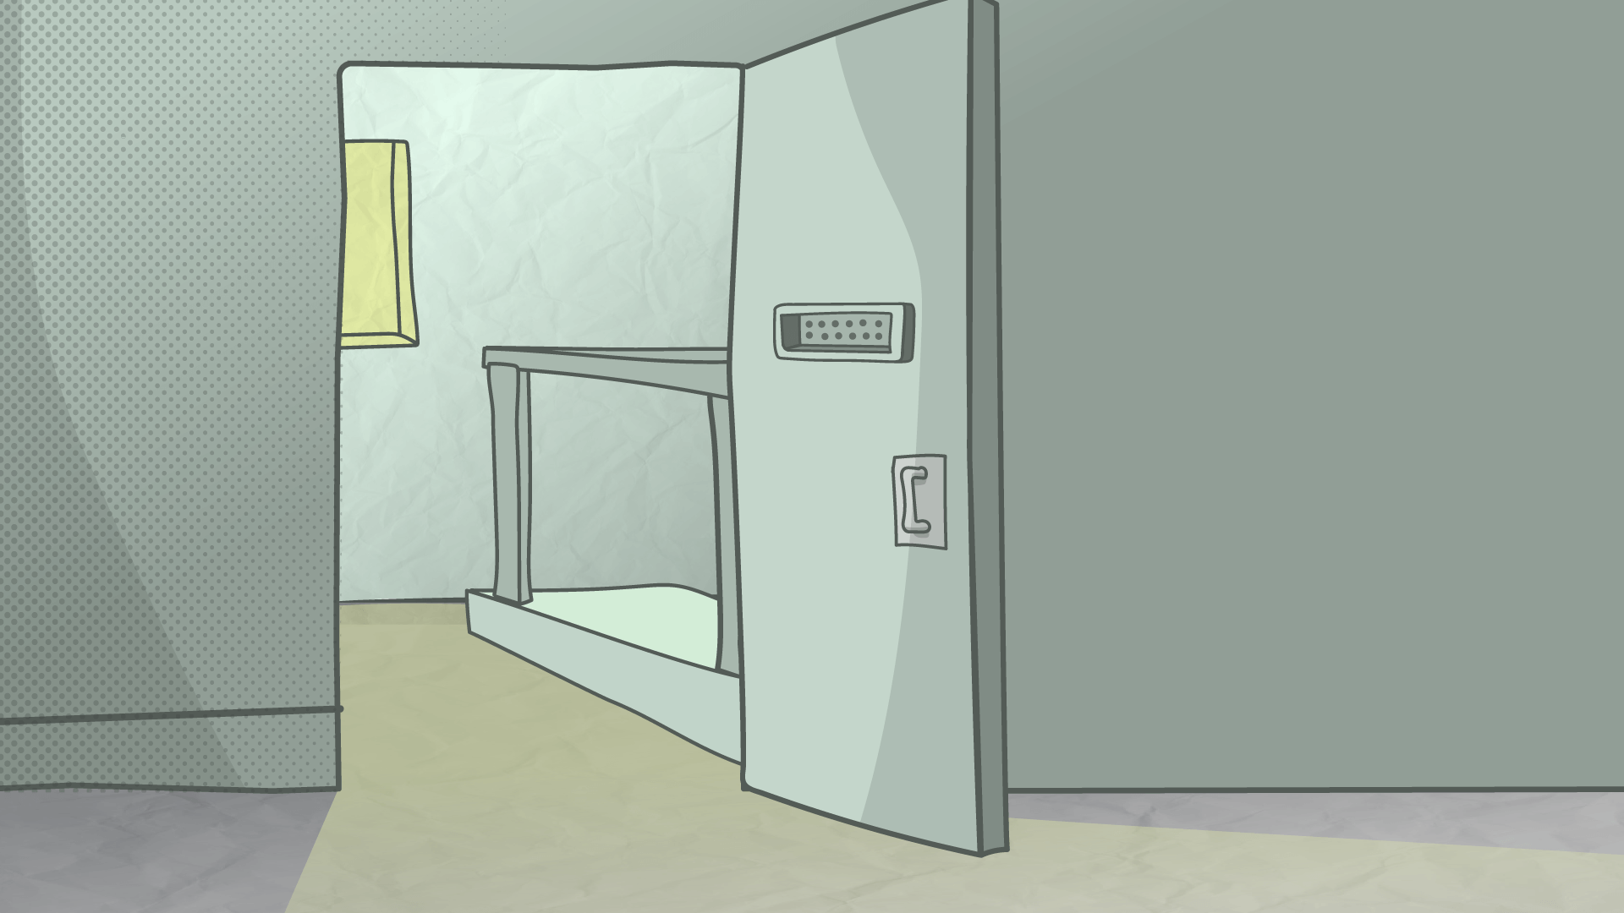
Practice activities
Working out
your settings

Slide 17
If you get tested, you’ll know where you stand and treatment is simple.
Practice activities
Working out
your messages
It’s simple to get cured. Talk to your mates about getting tested and treated.
Let’s talk
about hep C:
test, treat,
cure, prevent
– it's simple

Slide 18

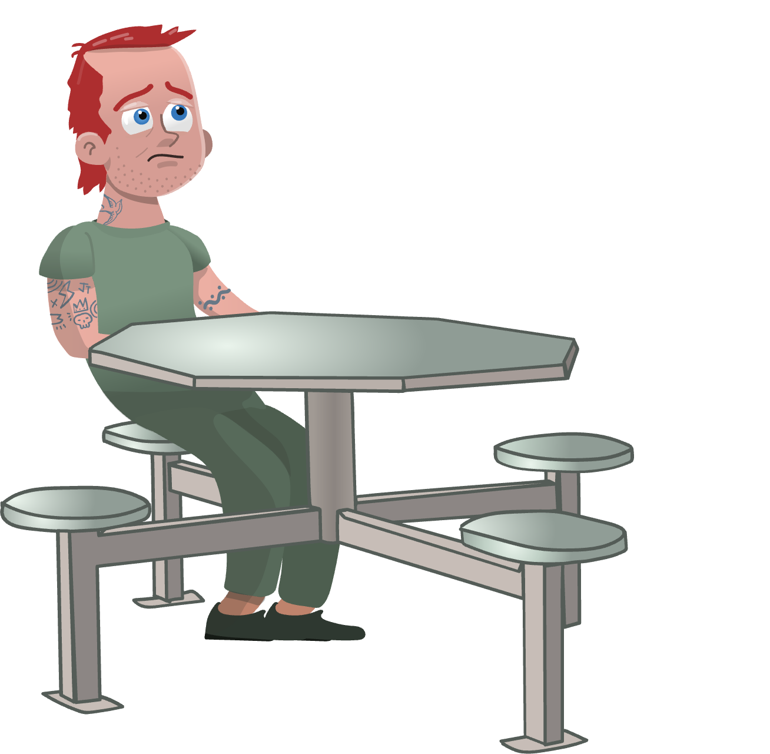
Practice activities
Facing tough
questions

Slide 19







This program was developed by:
In partnership with…
State and Territory Justice Health organisations
State and Territory Corrections Organisations
National and state-based Hepatitis and Drug-User Organisations
With funding from…

Slide 20
Post-session evaluation

